Slide 1




QA Automation Workshop
02/11/2023
Enda Brody

Slide 2


Agenda
Introductions
Set Up
Automation Pros and Cons, Paid vs Open-Source tools/frameworks.
Automation what are the different kinds the Testing cupcake . 🧁
Coding Challenges 🦾
Functional tests
Visual regression tests
Api calls and tests through the Web testing tool
How to code with Chat GPT
Pipelines
Microsoft Azure
Jenkins
To find out more additional resources Automation Testing 📚
BREAK ☕

Slide 3
Set Up
Install Java for windows
https://www.guru99.com/install-java.html
Install Eclipse IDE
https://www.guru99.com/install-eclipse-java.html
Install Selenium Webdriver for Java Client Driver
https://www.guru99.com/installing-selenium-webdriver.html
Install TestNg Plugin
https://www.browserstack.com/guide/how-to-install-testng-in-eclipse

Slide 4

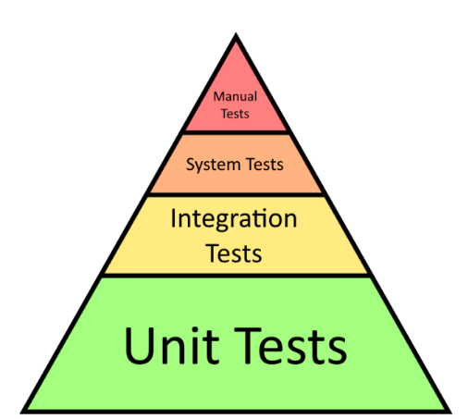
Automation what are the different kinds Testing cupcake . 🧁
UI functional End 2 end test
Api tests
Performance Tests (non-functional)
Visual Regression
Browser and Device tests(non-functioning)
Unit tests
Visual Regression
Visual Regression
Api Tests
UI End2end Functioning Tests
Unit Tests

Slide 5


Selenium Web Driver coding Challenges
CODING TIME !!!!
https://eyes.applitools.com/app/test-results/00000251715453221399/?accountId=7Qq1d3cZSUS0iZMQf_iddg__
https://apipheny.io/free-api/
Notes:
https://www.browserstack.com/guide/how-to-install-testng-in-eclipse https://eyes.applitools.com/

Slide 6
To find out more additional resources Automation Testing
https://www.guru99.com
https://applitools.com/tutorials/quickstart/web/selenium/java/junit

